Slide 1
Chapter 3
Arithmetic for Computers
Notes:
Morgan Kaufmann Publishers
Chapter 3 — Arithmetic for Computers

Slide 2
Arithmetic for Computers
§3.1 Introduction
Operations on integers
  Addition and subtraction
  Multiplication and division
  Dealing with overflow
Floating-point real numbers
  Representation and operations
Chapter 3 — Arithmetic for Computers — <number>
Notes:
Morgan Kaufmann Publishers
Chapter 3 — Arithmetic for Computers

Slide 3

Integer Addition
Example: 7 + 6
§3.2 Addition and Subtraction
Overflow if result out of range
  Adding +ve and –ve operands, no overflow
  Adding two +ve operands
    Overflow if result sign is 1
  Adding two –ve operands
    Overflow if result sign is 0
Chapter 3 — Arithmetic for Computers — <number>
Notes:
Morgan Kaufmann Publishers
Chapter 3 — Arithmetic for Computers

Slide 4
Integer Subtraction
Add negation of second operand
Example: 7 – 6 = 7 + (–6)
  +7: 0000 0000 … 0000 0111
  –6: 1111 1111 … 1111 1010
  +1: 0000 0000 … 0000 0001
Overflow if result out of range
  Subtracting two +ve or two –ve operands, no overflow
  Subtracting +ve from –ve operand
    Overflow if result sign is 0
  Subtracting –ve from +ve operand
    Overflow if result sign is 1
Chapter 3 — Arithmetic for Computers — <number>
Notes:
Morgan Kaufmann Publishers
Chapter 3 — Arithmetic for Computers

Slide 5
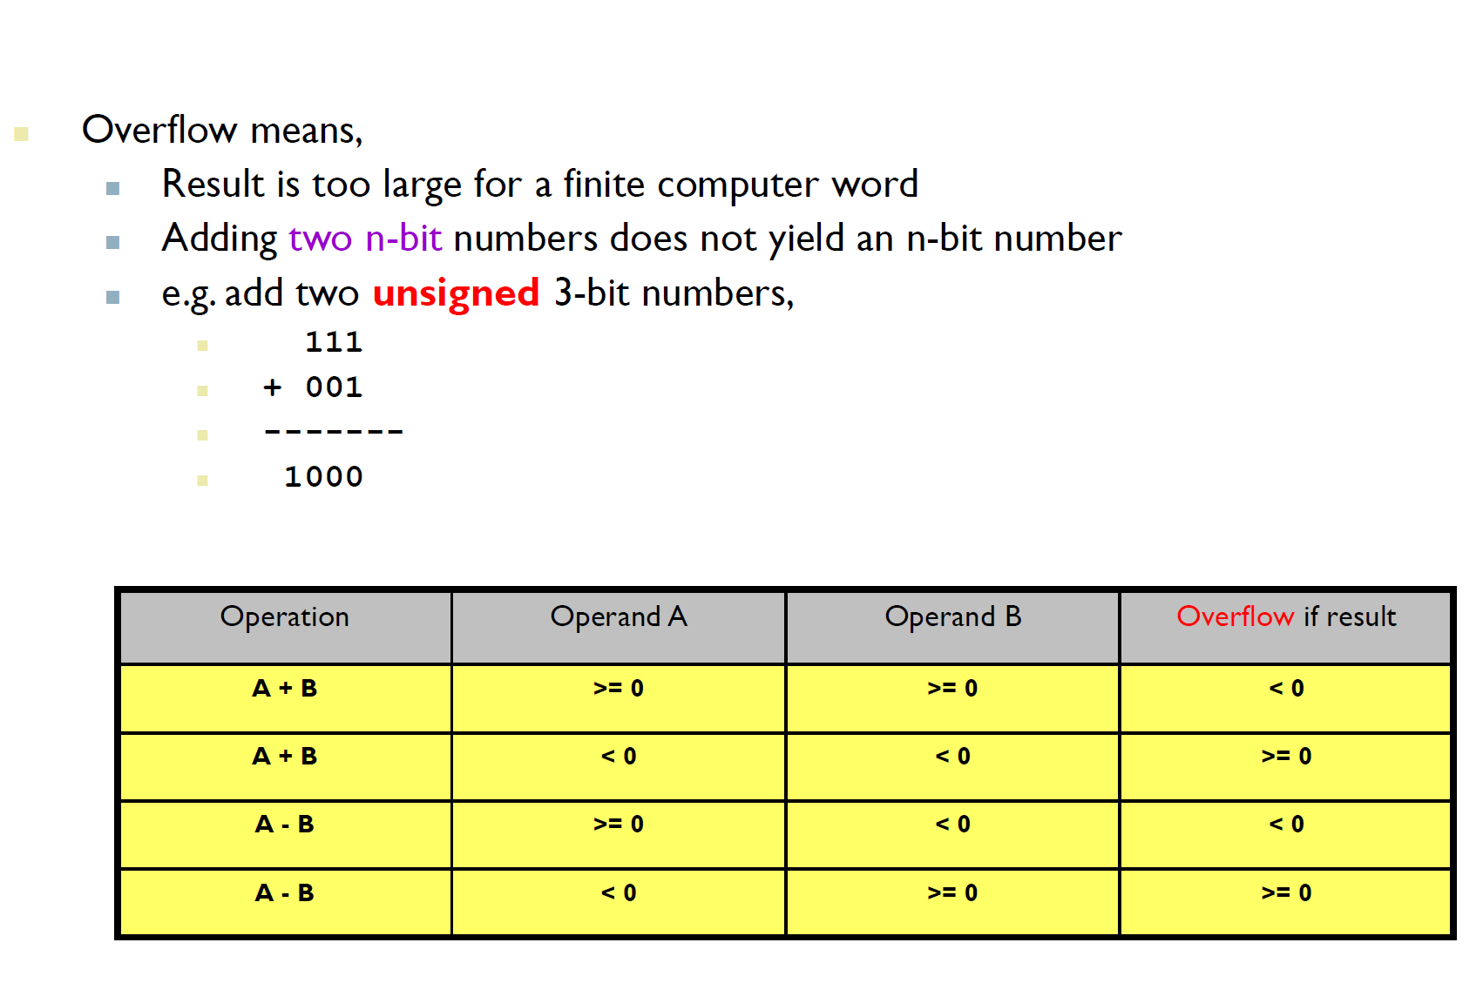
Overflow
Chapter 3 — Arithmetic for Computers — <number>

Slide 6
Arithmetic for Multimedia
Graphics and media processing operates on vectors of 8-bit and 16-bit data
  Use 64-bit adder, with partitioned carry chain
    Operate on 8×8-bit, 4×16-bit, or 2×32-bit vectors
  SIMD (single-instruction, multiple-data)
Saturating operations
  On overflow, result is largest representable value
    c.f. 2s-complement modulo arithmetic
  E.g., clipping in audio, saturation in video
Chapter 3 — Arithmetic for Computers — <number>
Notes:
Morgan Kaufmann Publishers
Chapter 3 — Arithmetic for Computers

Slide 7

Multiplication
§3.3 Multiplication
Start with long-multiplication approach
multiplicand
1000
× 1001
1000
0000
0000
1000
1001000
multiplier
product
Length of product is the sum of operand lengths
Chapter 3 — Arithmetic for Computers — <number>
Notes:
Morgan Kaufmann Publishers
Chapter 3 — Arithmetic for Computers

Slide 8
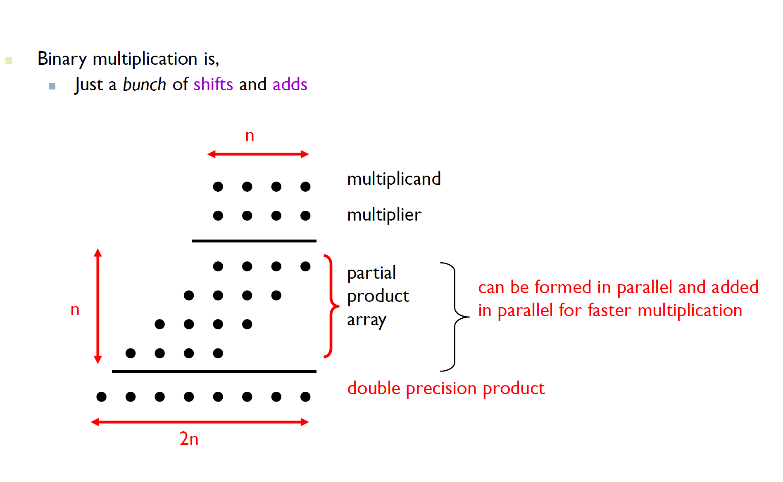
Multiplication (2)
Chapter 3 — Arithmetic for Computers — <number>

Slide 9
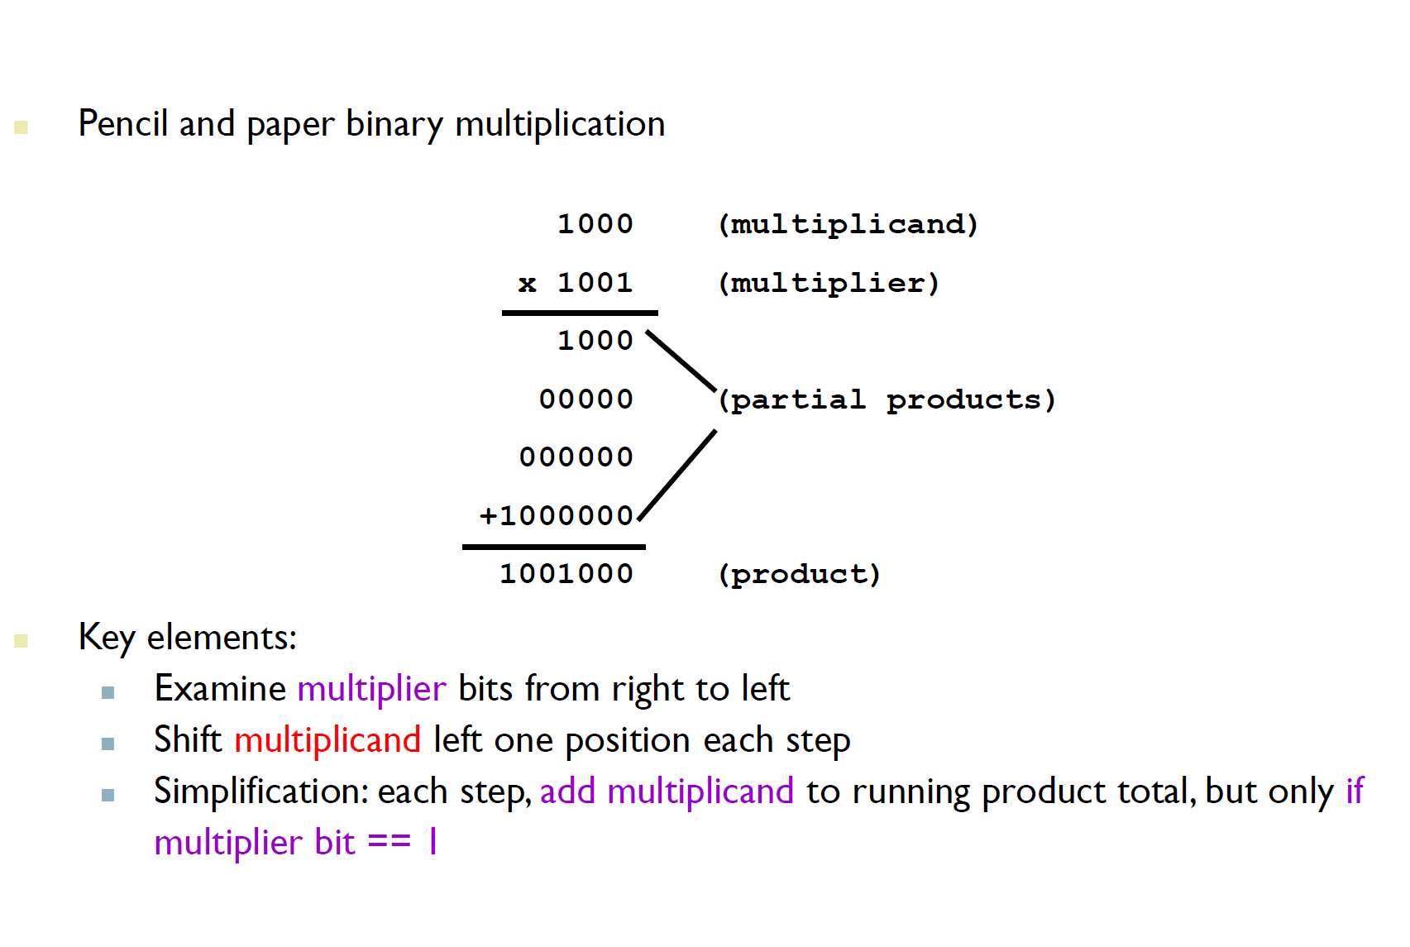

Integer Multiplication
Chapter 3 — Arithmetic for Computers — <number>

Slide 10
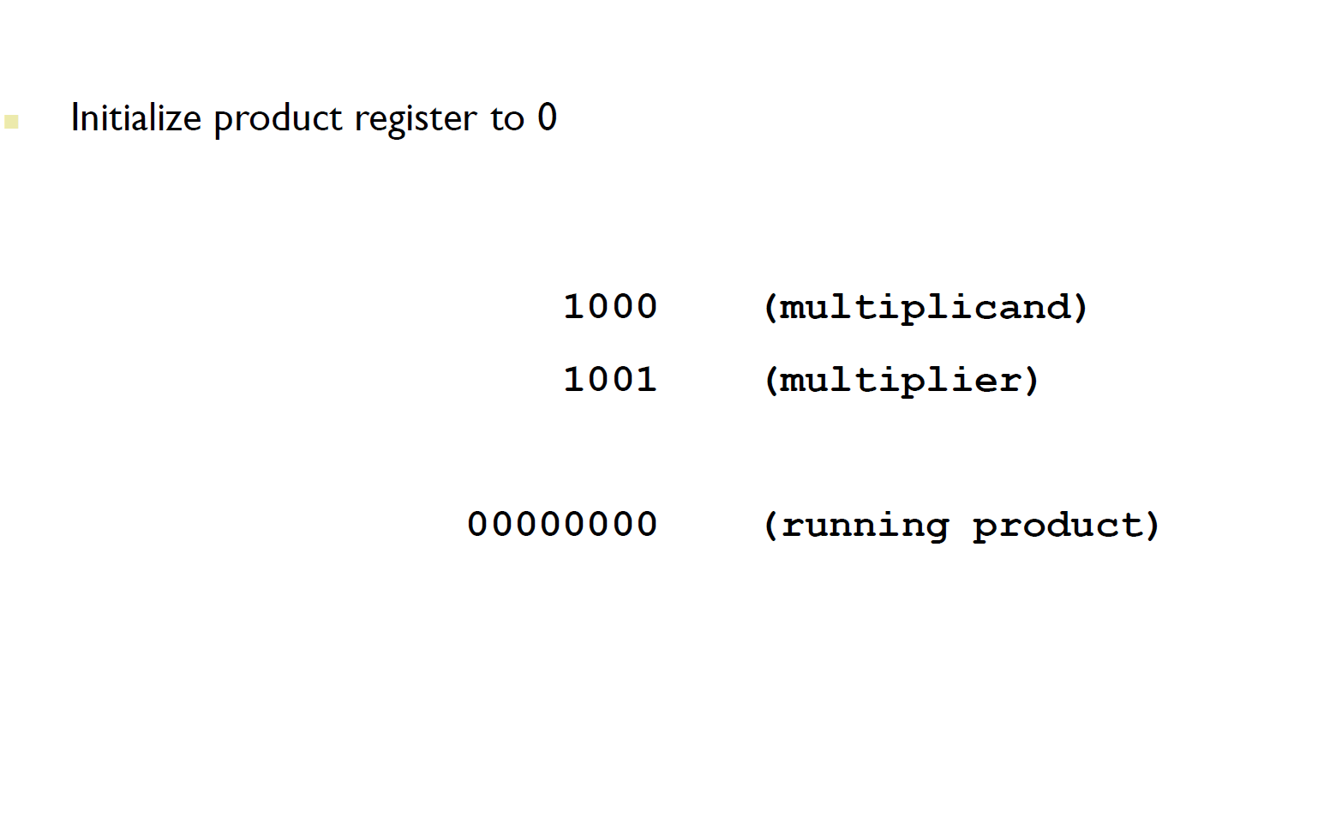
Integer Multiplication (2)
Chapter 3 — Arithmetic for Computers — <number>

Slide 11
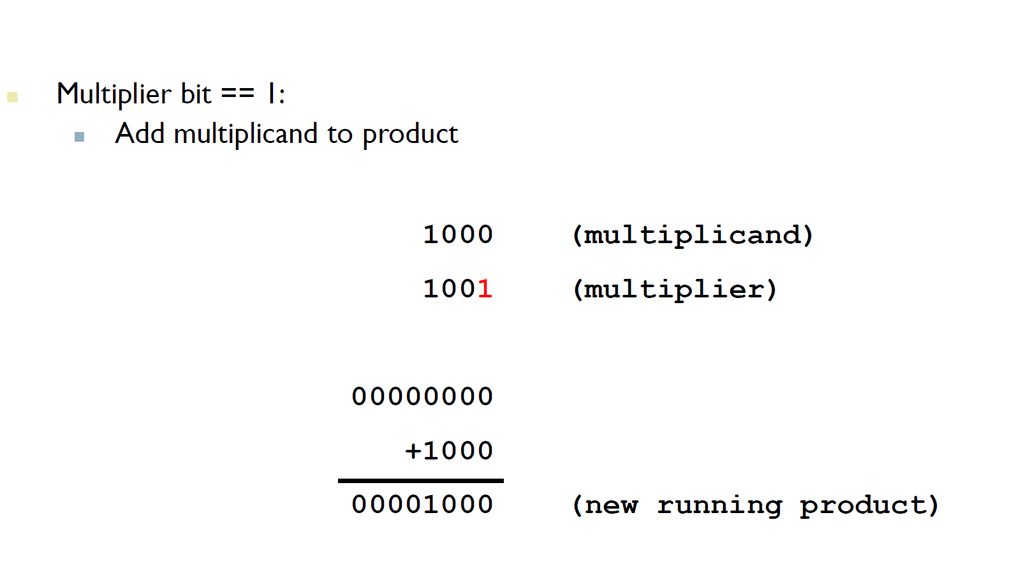
Integer Multiplication (3)
Chapter 3 — Arithmetic for Computers — <number>

Slide 12
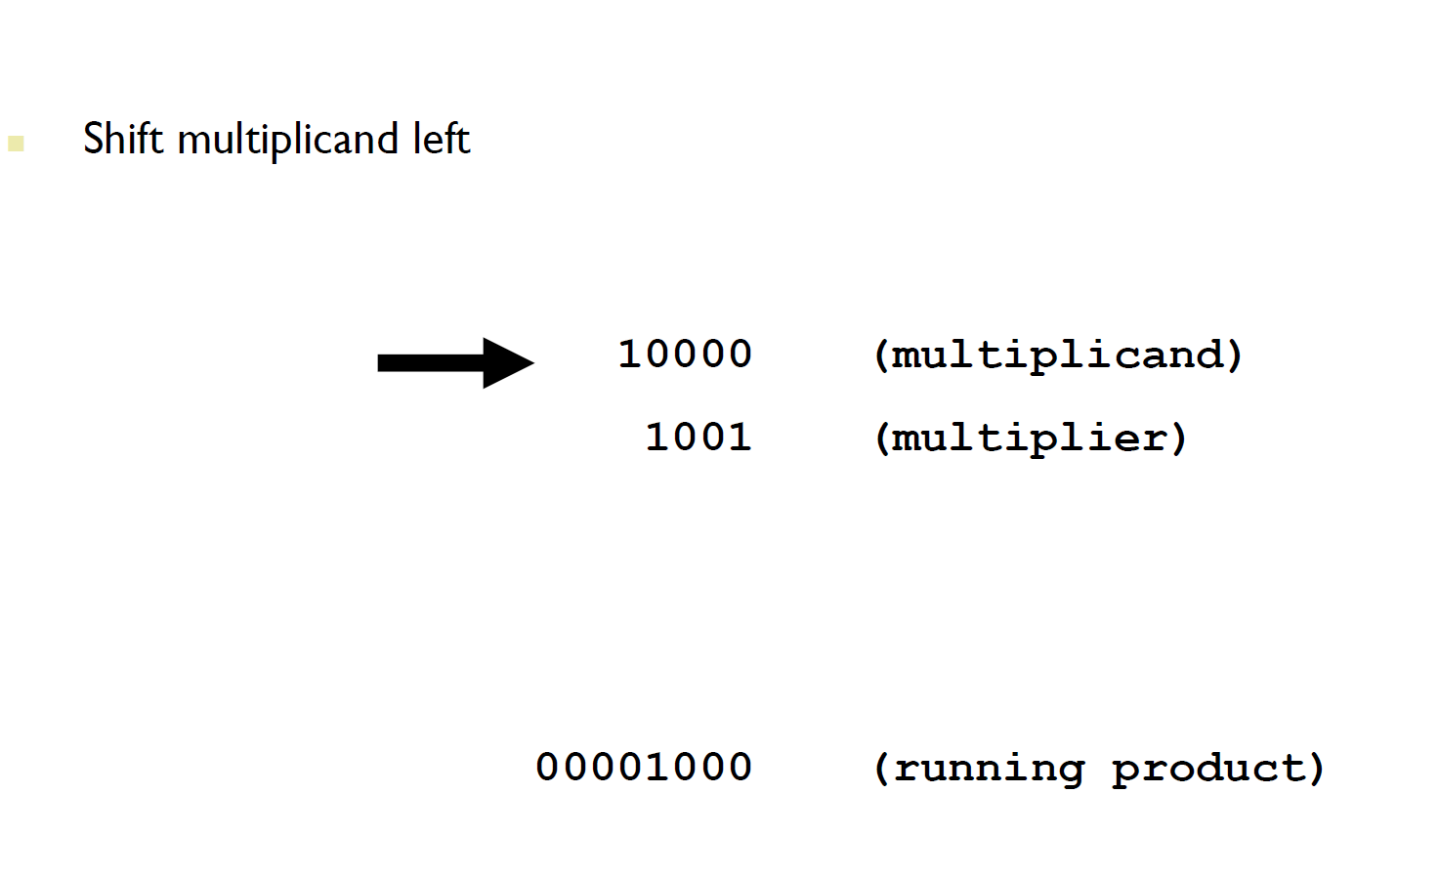
Integer Multiplication (4)
Chapter 3 — Arithmetic for Computers — <number>

Slide 13
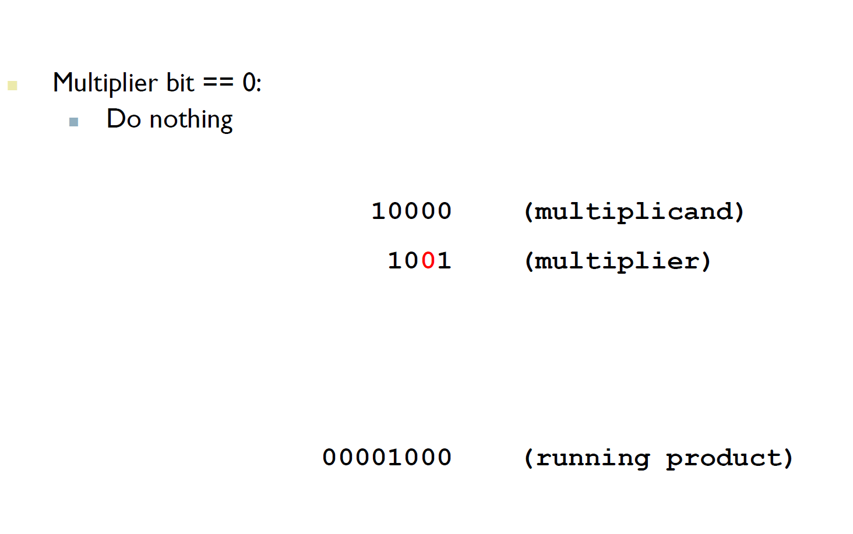
Integer Multiplication (5)
Chapter 3 — Arithmetic for Computers — <number>

Slide 14
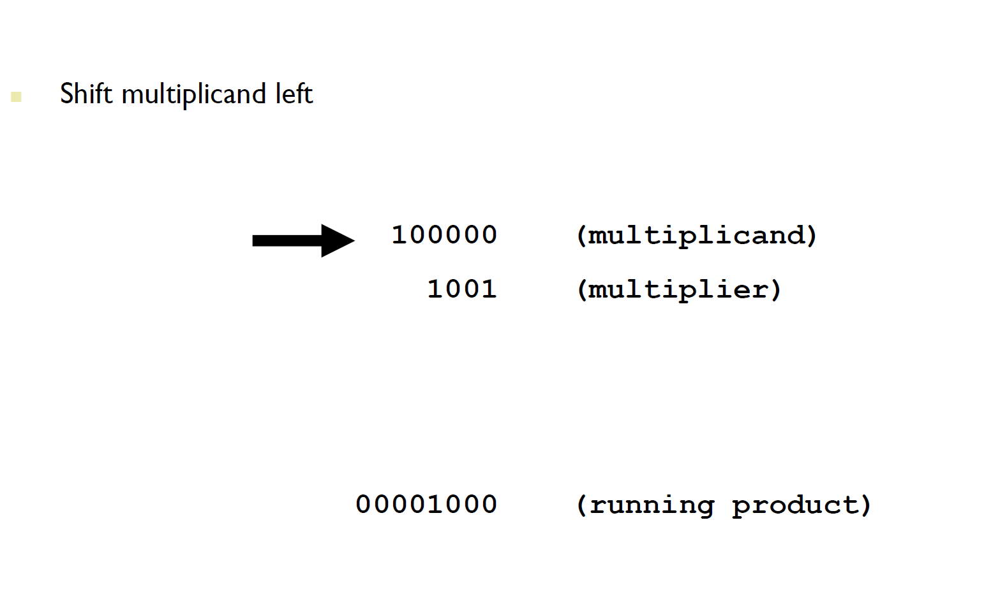
Integer Multiplication (6)
Chapter 3 — Arithmetic for Computers — <number>

Slide 15
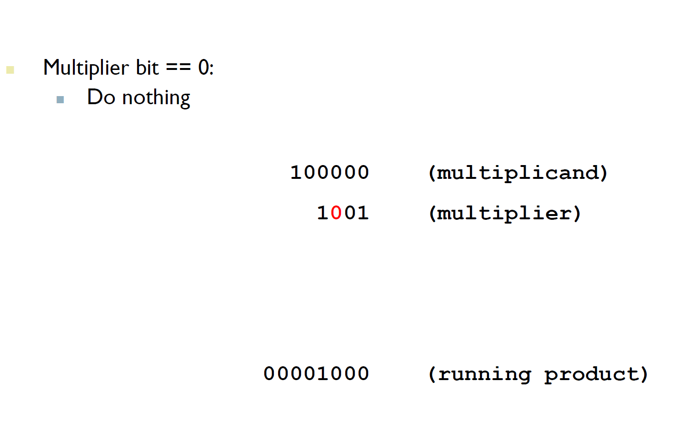
Integer Multiplication (7)
Chapter 3 — Arithmetic for Computers — <number>

Slide 16
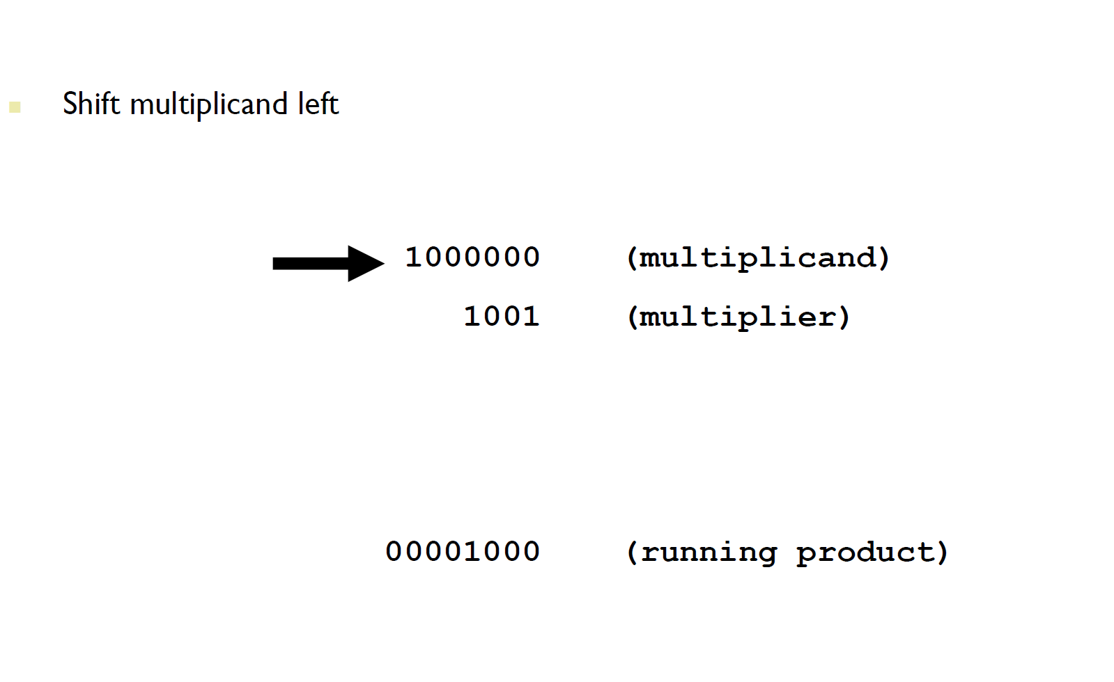
Integer Multiplication (8)
Chapter 3 — Arithmetic for Computers — <number>

Slide 17
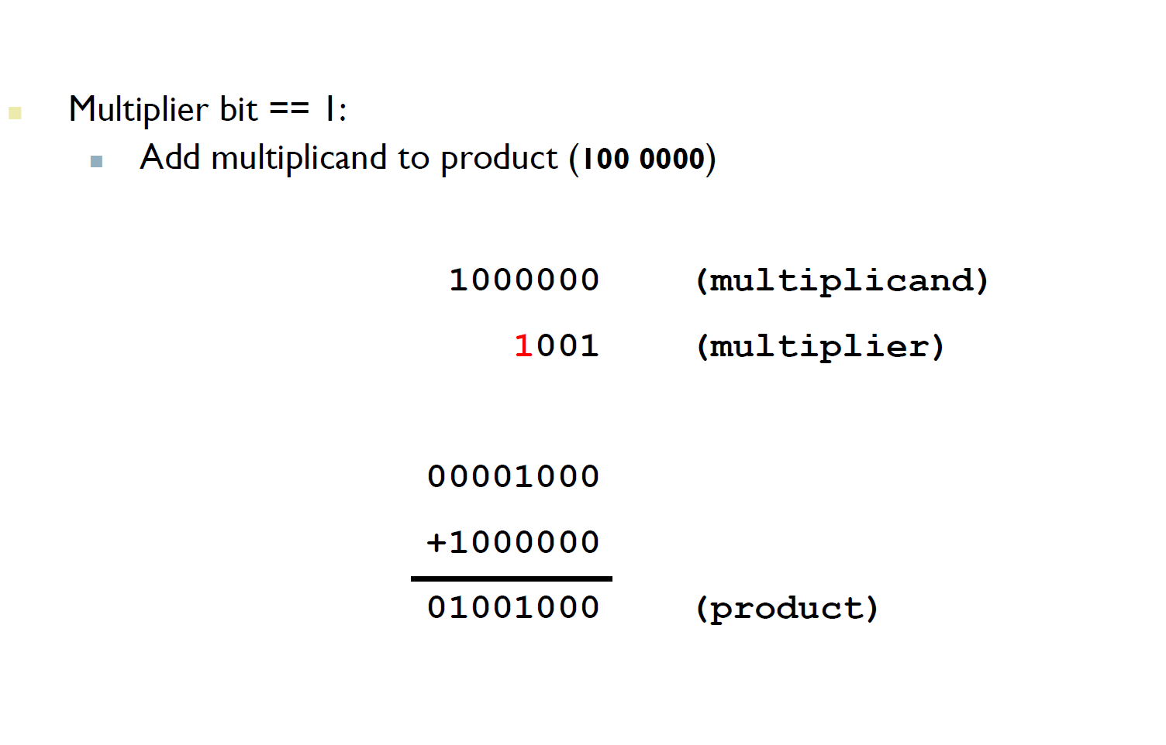
Integer Multiplication (9)
Chapter 3 — Arithmetic for Computers — <number>

Slide 18

Multiplication Hardware
Initially 0
Chapter 3 — Arithmetic for Computers — <number>
Notes:
Morgan Kaufmann Publishers
Chapter 3 — Arithmetic for Computers

Slide 19

Optimized Multiplier
Perform steps in parallel: add/shift
One cycle per partial-product addition
  That’s ok, if frequency of multiplications is low
Chapter 3 — Arithmetic for Computers — <number>
Notes:
Morgan Kaufmann Publishers
Chapter 3 — Arithmetic for Computers

Slide 20
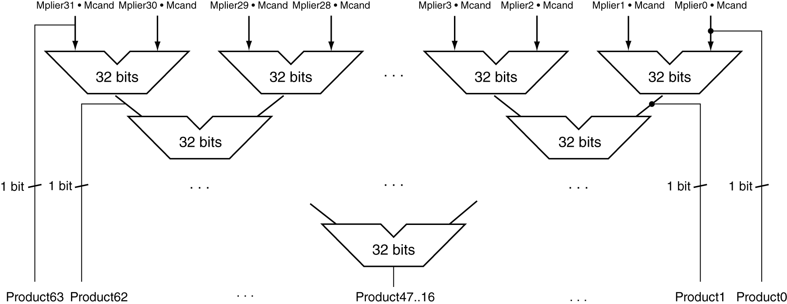
Faster Multiplier
Uses multiple adders
  Cost/performance tradeoff
Can be pipelined
  Several multiplication performed in parallel
Chapter 3 — Arithmetic for Computers — <number>
Notes:
Morgan Kaufmann Publishers
Chapter 3 — Arithmetic for Computers

Slide 21
LEGv8 Multiplication
Three multiply instructions:
  MUL: multiply
    Gives the lower 64 bits of the product
  SMULH: signed multiply high
    Gives the upper 64 bits of the product, assuming the operands are signed
  UMULH: unsigned multiply high
    Gives the lower 64 bits of the product, assuming the operands are unsigned
Chapter 3 — Arithmetic for Computers — <number>
Notes:
Morgan Kaufmann Publishers
Chapter 3 — Arithmetic for Computers

Slide 22
Division
§3.4 Division
Check for 0 divisor
Long division approach
  If divisor ≤ dividend bits
    1 bit in quotient, subtract
  Otherwise
    0 bit in quotient, bring down next dividend bit
Restoring division
  Do the subtract, and if remainder goes < 0, add divisor back
Signed division
  Divide using absolute values
  Adjust sign of quotient and remainder as required
quotient
dividend
1001
1000 1001010
-1000
10
101
1010
-1000
10
divisor
remainder
n-bit operands yield n-bit
quotient and remainder
Chapter 3 — Arithmetic for Computers — <number>
Notes:
Morgan Kaufmann Publishers
Chapter 3 — Arithmetic for Computers

Slide 23


Division Hardware
Initially divisor in left half
Initially dividend
Chapter 3 — Arithmetic for Computers — <number>
Notes:
Morgan Kaufmann Publishers
Chapter 3 — Arithmetic for Computers

Slide 24

Optimized Divider
One cycle per partial-remainder subtraction
Looks a lot like a multiplier!
  Same hardware can be used for both
Chapter 3 — Arithmetic for Computers — <number>
Notes:
Morgan Kaufmann Publishers
Chapter 3 — Arithmetic for Computers

Slide 25
Faster Division
Can’t use parallel hardware as in multiplier
  Subtraction is conditional on sign of remainder
Faster dividers (e.g. SRT devision) generate multiple quotient bits per step
  Still require multiple steps
Chapter 3 — Arithmetic for Computers — <number>
Notes:
Morgan Kaufmann Publishers
Chapter 3 — Arithmetic for Computers

Slide 26
LEGv8 Division
Two instructions:
  SDIV (signed)
  UDIV (unsigned)
Both instructions ignore overflow and division-by-zero
Chapter 3 — Arithmetic for Computers — <number>
Notes:
Morgan Kaufmann Publishers
Chapter 3 — Arithmetic for Computers

Slide 27
Floating Point
§3.5 Floating Point
Representation for non-integral numbers
  Including very small and very large numbers
Like scientific notation
  –2.34 × 10⁵⁶
  +0.002 × 10^{–4}
  +987.02 × 10⁹
In binary
  ±1.xxxxxxx₂ × 2^{yyyy}
Types float and double in C
normalized
not normalized
Chapter 3 — Arithmetic for Computers — <number>
Notes:
Morgan Kaufmann Publishers
Chapter 3 — Arithmetic for Computers

Slide 28
Floating Point Standard
Defined by IEEE Std 754-1985
Developed in response to divergence of representations
  Portability issues for scientific code
Now almost universally adopted
Two representations
  Single precision (32-bit)
  Double precision (64-bit)
Chapter 3 — Arithmetic for Computers — <number>
Notes:
Morgan Kaufmann Publishers
Chapter 3 — Arithmetic for Computers

Slide 29
IEEE Floating-Point Format
single: 8 bits
double: 11 bits
single: 23 bits
double: 52 bits
S
Exponent
Fraction
S: sign bit (0 ⇒ non-negative, 1 ⇒ negative)
Normalize significand: 1.0 ≤ |significand| < 2.0
  Always has a leading pre-binary-point 1 bit, so no need to represent it explicitly (hidden bit)
  Significand is Fraction with the “1.” restored
Exponent: excess representation: actual exponent + Bias
  Ensures exponent is unsigned
  Single: Bias = 127; Double: Bias = 1023
Chapter 3 — Arithmetic for Computers — <number>
Notes:
Morgan Kaufmann Publishers
Chapter 3 — Arithmetic for Computers

Slide 30
Single-Precision Range
Exponents 00000000 and 11111111 reserved
Smallest value
  Exponent: 00000001
  ⇒ actual exponent = 1 – 127 = –126
  Fraction: 000…00 ⇒ significand = 1.0
  ±1.0 × 2^{–126} ≈ ±1.2 × 10^{–38}
Largest value
  exponent: 11111110
  ⇒ actual exponent = 254 – 127 = +127
  Fraction: 111…11 ⇒ significand ≈ 2.0
  ±2.0 × 2⁺¹²⁷ ≈ ±3.4 × 10⁺³⁸
Chapter 3 — Arithmetic for Computers — <number>
Notes:
Morgan Kaufmann Publishers
Chapter 3 — Arithmetic for Computers

Slide 31
Double-Precision Range
Exponents 0000…00 and 1111…11 reserved
Smallest value
  Exponent: 00000000001
  ⇒ actual exponent = 1 – 1023 = –1022
  Fraction: 000…00 ⇒ significand = 1.0
  ±1.0 × 2^{–1022} ≈ ±2.2 × 10^{–308}
Largest value
  Exponent: 11111111110
  ⇒ actual exponent = 2046 – 1023 = +1023
  Fraction: 111…11 ⇒ significand ≈ 2.0
  ±2.0 × 2⁺¹⁰²³ ≈ ±1.8 × 10⁺³⁰⁸
Chapter 3 — Arithmetic for Computers — <number>
Notes:
Morgan Kaufmann Publishers
Chapter 3 — Arithmetic for Computers

Slide 32
Floating-Point Precision
Relative precision
  all fraction bits are significant
  Single: approx 2^{–23}
    Equivalent to 23 × log₁₀2 ≈ 23 × 0.3 ≈ 6 decimal digits of precision
  Double: approx 2^{–52}
    Equivalent to 52 × log₁₀2 ≈ 52 × 0.3 ≈ 16 decimal digits of precision
Chapter 3 — Arithmetic for Computers — <number>
Notes:
Morgan Kaufmann Publishers
Chapter 3 — Arithmetic for Computers

Slide 33
Floating-Point Example
Represent –0.75
  –0.75 = (–1)¹ × 1.1₂ × 2^{–1}
  S = 1
  Fraction = 1000…00₂
  Exponent = –1 + Bias
    Single: –1 + 127 = 126 = 01111110₂
    Double: –1 + 1023 = 1022 = 01111111110₂
Single: 1011111101000…00
Double: 1011111111101000…00
Chapter 3 — Arithmetic for Computers — <number>
Notes:
Morgan Kaufmann Publishers
Chapter 3 — Arithmetic for Computers

Slide 34
Floating-Point Example
What number is represented by the single-precision float
11000000101000…00
  S = 1
  Fraction = 01000…00₂
  Exponent = 10000001₂ = 129
x = (–1)¹ × (1 + 01₂) × 2^{(129 – 127)}
  = (–1) × 1.25 × 2²
  = –5.0
Chapter 3 — Arithmetic for Computers — <number>
Notes:
Morgan Kaufmann Publishers
Chapter 3 — Arithmetic for Computers

Slide 35


Denormal Numbers
Exponent = 000...0 ⇒ hidden bit is 0
Smaller than normal numbers
  allow for gradual underflow, with diminishing precision
Denormal with fraction = 000...0
Two representations of 0.0!
Chapter 3 — Arithmetic for Computers — <number>
Notes:
Morgan Kaufmann Publishers
Chapter 3 — Arithmetic for Computers

Slide 36
Infinities and NaNs
Exponent = 111...1, Fraction = 000...0
  ±Infinity
  Can be used in subsequent calculations, avoiding need for overflow check
Exponent = 111...1, Fraction ≠ 000...0
  Not-a-Number (NaN)
  Indicates illegal or undefined result
    e.g., 0.0 / 0.0
  Can be used in subsequent calculations
Chapter 3 — Arithmetic for Computers — <number>
Notes:
Morgan Kaufmann Publishers
Chapter 3 — Arithmetic for Computers

Slide 37
Floating-Point Addition
Consider a 4-digit decimal example
  9.999 × 10¹ + 1.610 × 10^{–1}
1. Align decimal points
  Shift number with smaller exponent
  9.999 × 10¹ + 0.016 × 10¹
2. Add significands
  9.999 × 10¹ + 0.016 × 10¹ = 10.015 × 10¹
3. Normalize result & check for over/underflow
  1.0015 × 10²
4. Round and renormalize if necessary
  1.002 × 10²
Chapter 3 — Arithmetic for Computers — <number>
Notes:
Morgan Kaufmann Publishers
Chapter 3 — Arithmetic for Computers

Slide 38
Floating-Point Addition
Now consider a 4-digit binary example
  1.000₂ × 2^{–1} + –1.110₂ × 2^{–2} (0.5 + –0.4375)
1. Align binary points
  Shift number with smaller exponent
  1.000₂ × 2^{–1} + –0.111₂ × 2^{–1}
2. Add significands
  1.000₂ × 2^{–1} + –0.111₂ × 2–1 = 0.001₂ × 2^{–1}
3. Normalize result & check for over/underflow
  1.000₂ × 2^{–4}, with no over/underflow
4. Round and renormalize if necessary
  1.000₂ × 2^{–4} (no change) = 0.0625
Chapter 3 — Arithmetic for Computers — <number>
Notes:
Morgan Kaufmann Publishers
Chapter 3 — Arithmetic for Computers

Slide 39
FP Adder Hardware
Much more complex than integer adder
Doing it in one clock cycle would take too long
  Much longer than integer operations
  Slower clock would penalize all instructions
FP adder usually takes several cycles
  Can be pipelined
Chapter 3 — Arithmetic for Computers — <number>
Notes:
Morgan Kaufmann Publishers
Chapter 3 — Arithmetic for Computers

Slide 40

FP Adder Hardware
Step 1
Step 2
Step 3
Step 4
Chapter 3 — Arithmetic for Computers — <number>
Notes:
Morgan Kaufmann Publishers
Chapter 3 — Arithmetic for Computers

Slide 41
Floating-Point Multiplication
Consider a 4-digit decimal example
  1.110 × 10¹⁰ × 9.200 × 10^{–5}
1. Add exponents
  For biased exponents, subtract bias from sum
  New exponent = 10 + –5 = 5
2. Multiply significands
  1.110 × 9.200 = 10.212 ⇒ 10.212 × 10⁵
3. Normalize result & check for over/underflow
  1.0212 × 10⁶
4. Round and renormalize if necessary
  1.021 × 10⁶
5. Determine sign of result from signs of operands
  +1.021 × 10⁶
Chapter 3 — Arithmetic for Computers — <number>
Notes:
Morgan Kaufmann Publishers
Chapter 3 — Arithmetic for Computers

Slide 42
Floating-Point Multiplication
Now consider a 4-digit binary example
  1.000₂ × 2^{–1} × –1.110₂ × 2^{–2} (0.5 × –0.4375)
1. Add exponents
  Unbiased: –1 + –2 = –3
  Biased: (–1 + 127) + (–2 + 127) = –3 + 254 – 127 = –3 + 127
2. Multiply significands
  1.000₂ × 1.110₂ = 1.1102 ⇒ 1.110₂ × 2^{–3}
3. Normalize result & check for over/underflow
  1.110₂ × 2^{–3} (no change) with no over/underflow
4. Round and renormalize if necessary
  1.110₂ × 2^{–3} (no change)
5. Determine sign: +ve × –ve ⇒ –ve
  –1.110₂ × 2^{–3} = –0.21875
Chapter 3 — Arithmetic for Computers — <number>
Notes:
Morgan Kaufmann Publishers
Chapter 3 — Arithmetic for Computers

Slide 43
FP Arithmetic Hardware
FP multiplier is of similar complexity to FP adder
  But uses a multiplier for significands instead of an adder
FP arithmetic hardware usually does
  Addition, subtraction, multiplication, division, reciprocal, square-root
  FP ↔ integer conversion
Operations usually takes several cycles
  Can be pipelined
Chapter 3 — Arithmetic for Computers — <number>
Notes:
Morgan Kaufmann Publishers
Chapter 3 — Arithmetic for Computers

Slide 44
FP Instructions in LEGv8
Separate FP registers
  32 single-precision: S0, …, S31
  32 double-precision: DS0, …, D31
  Sn stored in the lower 32 bits of Dn
FP instructions operate only on FP registers
  Programs generally don’t do integer ops on FP data, or vice versa
  More registers with minimal code-size impact
FP load and store instructions
  LDURS, LDURD
  STURS, STURD
Chapter 3 — Arithmetic for Computers — <number>
Notes:
Morgan Kaufmann Publishers
Chapter 3 — Arithmetic for Computers

Slide 45
FP Instructions in LEGv8
Single-precision arithmetic
  FADDS, FSUBS, FMULS, FDIVS
    e.g., FADDS S2, S4, S6
Double-precision arithmetic
  FADDD, FSUBD, FMULD, FDIVD
    e.g., FADDD D2, D4, D6
Single- and double-precision comparison
  FCMPS, FCMPD
  Sets or clears FP condition-code bits
Branch on FP condition code true or false
  B.cond
Chapter 3 — Arithmetic for Computers — <number>
Notes:
Morgan Kaufmann Publishers
Chapter 3 — Arithmetic for Computers

Slide 46
FP Example: °F to °C
C code:
float f2c (float fahr) {
return ((5.0/9.0)*(fahr - 32.0));
}
  fahr in S12, result in S0, literals in global memory space
Compiled LEGv8 code:
f2c:
LDURS S16, [X27,const5] // S16 = 5.0 (5.0 in memory)
LDURS S18, [X27,const9] // S18 = 9.0 (9.0 in memory)
FDIVS S16, S16, S18 // S16 = 5.0 / 9.0
LDURS S18, [X27,const32] // S18 = 32.0
FSUBS S18, S12, S18 // S18 = fahr – 32.0
FMULS S0, S16, S18 // S0 = (5/9)*(fahr – 32.0)
BR LR // return
Chapter 3 — Arithmetic for Computers — <number>
Notes:
Morgan Kaufmann Publishers
Chapter 3 — Arithmetic for Computers

Slide 47
FP Example: Array Multiplication
X = X + Y × Z
  All 32 × 32 matrices, 64-bit double-precision elements
C code:
void mm (double x[][],
double y[][], double z[][]) {
int i, j, k;
for (i = 0; i! = 32; i = i + 1)
for (j = 0; j! = 32; j = j + 1)
for (k = 0; k! = 32; k = k + 1)
x[i][j] = x[i][j]
+ y[i][k] * z[k][j];
}
  Addresses of x, y, z in X0, X1, X2, and
  i, j, k in X19, X20, X21
Chapter 3 — Arithmetic for Computers — <number>
Notes:
Morgan Kaufmann Publishers
Chapter 3 — Arithmetic for Computers

Slide 48
FP Example: Array Multiplication
LEGv8 code:
mm:...
LDI X10, 32 // X10 = 32 (row size/loop end)
LDI X19, 0 // i = 0; initialize 1st for loop
L1: LDI X20, 0 // j = 0; restart 2nd for loop
L2: LDI X21, 0 // k = 0; restart 3rd for loop
LSL X11, X19, 5 // X11 = i * 2 5 (size of row of c)
ADD X11, X11, X20 // X11 = i * size(row) + j
LSL X11, X11, 3 // X11 = byte offset of [i][j]
ADD X11, X0, X11 // X11 = byte address of c[i][j]
LDURD D4, [X11,#0] // D4 = 8 bytes of c[i][j]
L3: LSL X9, X21, 5 // X9 = k * 2 5 (size of row of b)
ADD X9, X9, X20 // X9 = k * size(row) + j
LSL X9, X9, 3 // X9 = byte offset of [k][j]
ADD X9, X2, X9 // X9 = byte address of b[k][j]
LDURD D16, [X9,#0] // D16 = 8 bytes of b[k][j]
LSL X9, X19, 5 // X9 = i * 2 5 (size of row of a)
Chapter 3 — Arithmetic for Computers — <number>
Notes:
Morgan Kaufmann Publishers
Chapter 3 — Arithmetic for Computers

Slide 49
FP Example: Array Multiplication
…
ADD X9, X9, X21 // X9 = i * size(row) + k
LSL X9, X9, 3 // X9 = byte offset of [i][k]
ADD X9, X1, X9 // X9 = byte address of a[i][k]
LDURD D18, [X9,#0] // D18 = 8 bytes of a[i][k]
FMULD D16, D18, D16 // D16 = a[i][k] * b[k][j]
FADDD D4, D4, D16 // f4 = c[i][j] + a[i][k] * b[k][j]
ADDI X21, X21, 1 // $k = k + 1
CMP X21, X10 // test k vs. 32
B.LT L3 // if (k < 32) go to L3
STURD D4, [X11,0] // = D4
ADDI X20, X20, #1 // $j = j + 1
CMP X20, X10 // test j vs. 32
B.LT L2 // if (j < 32) go to L2
ADDI X19, X19, #1 // $i = i + 1
CMP X19, X10 // test i vs. 32
B.LT L1 // if (i < 32) go to L1
Chapter 3 — Arithmetic for Computers — <number>
Notes:
Morgan Kaufmann Publishers
Chapter 3 — Arithmetic for Computers

Slide 50
Accurate Arithmetic
IEEE Std 754 specifies additional rounding control
  Extra bits of precision (guard, round, sticky)
  Choice of rounding modes
  Allows programmer to fine-tune numerical behavior of a computation
Not all FP units implement all options
  Most programming languages and FP libraries just use defaults
Trade-off between hardware complexity, performance, and market requirements
Chapter 3 — Arithmetic for Computers — <number>
Notes:
Morgan Kaufmann Publishers
Chapter 3 — Arithmetic for Computers

Slide 51
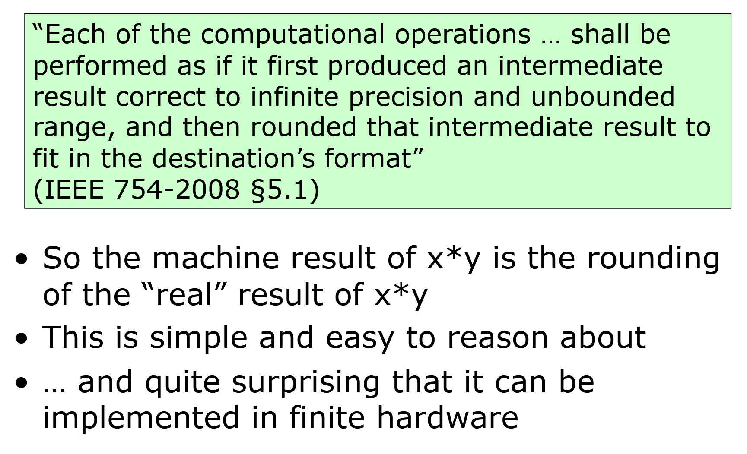
Basic Principle of IEEE FP
Chapter 3 — Arithmetic for Computers — <number>

Slide 52
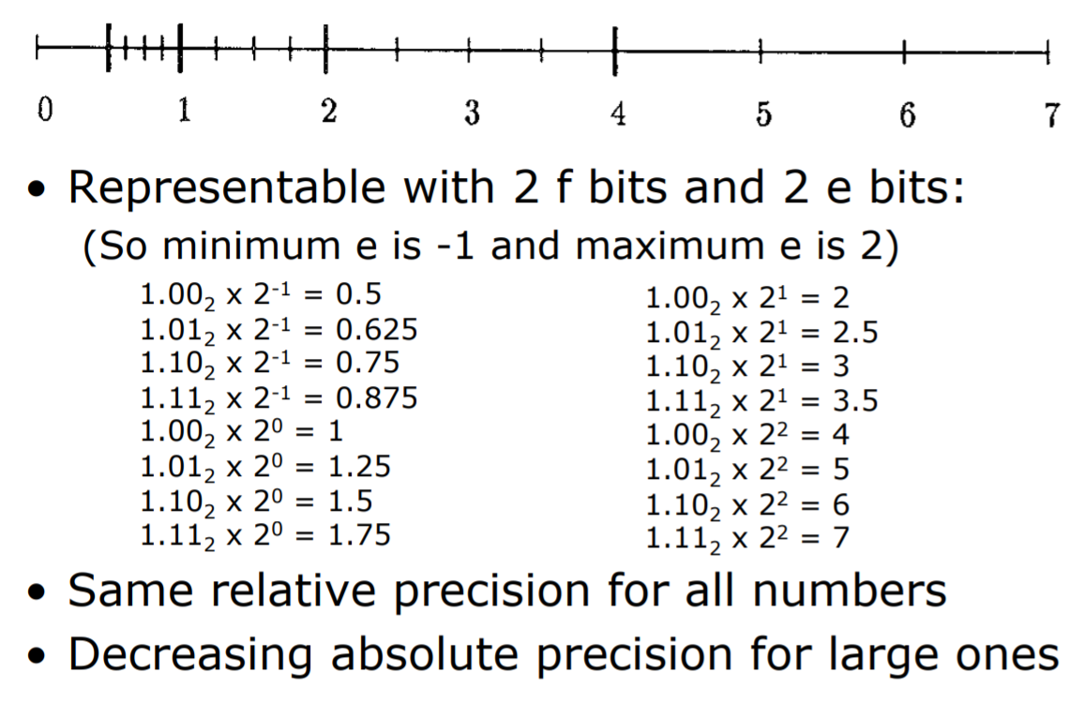
Normalized Number Line
Chapter 3 — Arithmetic for Computers — <number>

Slide 53
Subword Parallellism
Graphics and audio applications can take advantage of performing simultaneous operations on short vectors
  Example: 128-bit adder:
    Sixteen 8-bit adds
    Eight 16-bit adds
    Four 32-bit adds
Also called data-level parallelism, vector parallelism, or Single Instruction, Multiple Data (SIMD)
§3.6 Parallelism and Computer Arithmetic: Subword Parallelism
Chapter 3 — Arithmetic for Computers — <number>

Slide 54
ARMv8 SIMD
32 128-bit registers (V0, …, V31)
Works with integer and FP
Examples:
  16 8-bit integer adds:
  ADD V1.16B, V2.16B, V3.16B
  4 32-bit FP adds:
  FADD V1.4S, V2.4S, V3.4S
Chapter 3 — Arithmetic for Computers — <number>

Slide 55
Other ARMv8 Features
245 SIMD instructions, including:
  Square root
  Fused multiply-add, multiply-subtract
  Convertion and scalar and vector round-to-integral
  Structured (strided) vector load/stores
  Saturating arithmetic
Chapter 3 — Arithmetic for Computers — <number>

Slide 56
x86 FP Architecture
Originally based on 8087 FP coprocessor
  8 × 80-bit extended-precision registers
  Used as a push-down stack
  Registers indexed from TOS: ST(0), ST(1), …
FP values are 32-bit or 64 in memory
  Converted on load/store of memory operand
  Integer operands can also be converted
  on load/store
Very difficult to generate and optimize code
  Result: poor FP performance
§3.7 Real Stuff: Streaming SIMD Extensions and AVX in x86
Chapter 3 — Arithmetic for Computers — <number>
Notes:
Morgan Kaufmann Publishers
Chapter 3 — Arithmetic for Computers

Slide 57
x86 FP Instructions
Data transfer | Arithmetic | Compare | Transcendental
FILD mem/ST(i) FISTP mem/ST(i) FLDPI FLD1 FLDZ | FIADDP mem/ST(i) FISUBRP mem/ST(i) FIMULP mem/ST(i) FIDIVRP mem/ST(i) FSQRT FABS FRNDINT | FICOMP FIUCOMP FSTSW AX/mem | FPATAN F2XMI FCOS FPTAN FPREM FPSIN FYL2X
Optional variations
  I: integer operand
  P: pop operand from stack
  R: reverse operand order
  But not all combinations allowed
Chapter 3 — Arithmetic for Computers — <number>
Notes:
Morgan Kaufmann Publishers
Chapter 3 — Arithmetic for Computers

Slide 58
Streaming SIMD Extension 2 (SSE2)
Adds 4 × 128-bit registers
  Extended to 8 registers in AMD64/EM64T
Can be used for multiple FP operands
  2 × 64-bit double precision
  4 × 32-bit double precision
  Instructions operate on them simultaneously
    Single-Instruction Multiple-Data
Chapter 3 — Arithmetic for Computers — <number>
Notes:
Morgan Kaufmann Publishers
Chapter 3 — Arithmetic for Computers

Slide 59
Matrix Multiply
Unoptimized code:
1. void dgemm (int n, double* A, double* B, double* C)
2. {
3. for (int i = 0; i < n; ++i)
4. for (int j = 0; j < n; ++j)
5. {
6. double cij = C[i+j*n]; /* cij = C[i][j] */
7. for(int k = 0; k < n; k++ )
8. cij += A[i+k*n] * B[k+j*n]; /* cij += A[i][k]*B[k][j] */
9. C[i+j*n] = cij; /* C[i][j] = cij */
10. }
11. }
§3.8 Going Faster: Subword Parallelism and Matrix Multiply
Chapter 3 — Arithmetic for Computers — <number>

Slide 60
Matrix Multiply
x86 assembly code:
1. vmovsd (%r10),%xmm0 # Load 1 element of C into %xmm0
2. mov %rsi,%rcx # register %rcx = %rsi
3. xor %eax,%eax # register %eax = 0
4. vmovsd (%rcx),%xmm1 # Load 1 element of B into %xmm1
5. add %r9,%rcx # register %rcx = %rcx + %r9
6. vmulsd (%r8,%rax,8),%xmm1,%xmm1 # Multiply %xmm1, element of A
7. add $0x1,%rax # register %rax = %rax + 1
8. cmp %eax,%edi # compare %eax to %edi
9. vaddsd %xmm1,%xmm0,%xmm0 # Add %xmm1, %xmm0
10. jg 30 <dgemm+0x30> # jump if %eax > %edi
11. add $0x1,%r11d # register %r11 = %r11 + 1
12. vmovsd %xmm0,(%r10) # Store %xmm0 into C element
§3.8 Going Faster: Subword Parallelism and Matrix Multiply
Chapter 3 — Arithmetic for Computers — <number>

Slide 61
Matrix Multiply
Optimized C code:
1. #include <x86intrin.h>
2. void dgemm (int n, double* A, double* B, double* C)
3. {
4. for ( int i = 0; i < n; i+=4 )
5. for ( int j = 0; j < n; j++ ) {
6. __m256d c0 = _mm256_load_pd(C+i+j*n); /* c0 = C[i][j] */
7. for( int k = 0; k < n; k++ )
8. c0 = _mm256_add_pd(c0, /* c0 += A[i][k]*B[k][j] */
9. _mm256_mul_pd(_mm256_load_pd(A+i+k*n),
10. _mm256_broadcast_sd(B+k+j*n)));
11. _mm256_store_pd(C+i+j*n, c0); /* C[i][j] = c0 */
12. }
13. }
§3.8 Going Faster: Subword Parallelism and Matrix Multiply
Chapter 3 — Arithmetic for Computers — <number>

Slide 62
Matrix Multiply
Optimized x86 assembly code:
1. vmovapd (%r11),%ymm0 # Load 4 elements of C into %ymm0
2. mov %rbx,%rcx # register %rcx = %rbx
3. xor %eax,%eax # register %eax = 0
4. vbroadcastsd (%rax,%r8,1),%ymm1 # Make 4 copies of B element
5. add $0x8,%rax # register %rax = %rax + 8
6. vmulpd (%rcx),%ymm1,%ymm1 # Parallel mul %ymm1,4 A elements
7. add %r9,%rcx # register %rcx = %rcx + %r9
8. cmp %r10,%rax # compare %r10 to %rax
9. vaddpd %ymm1,%ymm0,%ymm0 # Parallel add %ymm1, %ymm0
10. jne 50 <dgemm+0x50> # jump if not %r10 != %rax
11. add $0x1,%esi # register % esi = % esi + 1
12. vmovapd %ymm0,(%r11) # Store %ymm0 into 4 C elements
§3.8 Going Faster: Subword Parallelism and Matrix Multiply
Chapter 3 — Arithmetic for Computers — <number>

Slide 63
Right Shift and Division
Left shift by i places multiplies an integer by 2^{i}
Right shift divides by 2^{i}?
  Only for unsigned integers
For signed integers
  Arithmetic right shift: replicate the sign bit
  e.g., –5 / 4
    11111011₂ >> 2 = 11111110₂ = –2
    Rounds toward –∞
  c.f. 11111011₂ >>> 2 = 00111110₂ = +62
§3.9 Fallacies and Pitfalls
Chapter 3 — Arithmetic for Computers — <number>
Notes:
Morgan Kaufmann Publishers
Chapter 3 — Arithmetic for Computers

Slide 64

Associativity
Parallel programs may interleave operations in unexpected orders
  Assumptions of associativity may fail
Need to validate parallel programs under varying degrees of parallelism
Chapter 3 — Arithmetic for Computers — <number>
Notes:
Morgan Kaufmann Publishers
Chapter 3 — Arithmetic for Computers

Slide 65
Who Cares About FP Accuracy?
Important for scientific code
  But for everyday consumer use?
    “My bank balance is out by 0.0002¢!” ☹
The Intel Pentium FDIV bug
  The market expects accuracy
  See Colwell, The Pentium Chronicles
Chapter 3 — Arithmetic for Computers — <number>
Notes:
Morgan Kaufmann Publishers
Chapter 3 — Arithmetic for Computers

Slide 66
Concluding Remarks
Bits have no inherent meaning
  Interpretation depends on the instructions applied
Computer representations of numbers
  Finite range and precision
  Need to account for this in programs
§3.9 Concluding Remarks
Chapter 3 — Arithmetic for Computers — <number>
Notes:
Morgan Kaufmann Publishers
Chapter 3 — Arithmetic for Computers

Slide 67
Concluding Remarks
ISAs support arithmetic
  Signed and unsigned integers
  Floating-point approximation to reals
Bounded range and precision
  Operations can overflow and underflow
Chapter 3 — Arithmetic for Computers — <number>
Notes:
Morgan Kaufmann Publishers
Chapter 3 — Arithmetic for Computers

